Slide 1

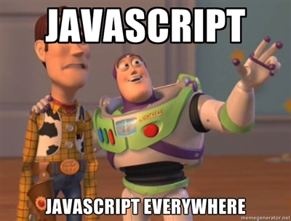
Course Presentation
HTML5, Advanced JavaScript
and Mobile Development

Slide 2


Course Presentation
Agenda
Your Full Professor. Who is he and what he did.
The course of this year. What are the topics we’ll cover, assessments, …
Resources.
Questions.

Slide 3

Your Full Professor
Course Presentation

Slide 4





Your Full Professor
In a few words…
Experiences :
- SUPINFO Trainer since 2009
- Bug Out PC
ADF
Adullact
Webpulser
Audaxis
Groupe Open
Atos Worldline
Xebia IT
Educations :
DUT Informatique / Montpellier
SUPINFO / Montpellier / Lille
- 59253@supinfo.com
brice.argenson
@bargenson
Certifications :
SCJP 6
SCWCD 5
Novell CLA
MS 70-316

Slide 5
The course of this year
Course Presentation

Slide 6

The course of this year
Topics
Sequence 1:
REST
Advanced JavaScript
Introduction to HTML5
New Markups
New APIs
CSS3
Graphics API
Sequence 2:
Server Events
Offline web
Web Mobile
Web Applications
Introduction to Node.js
Wakanda

Slide 7





The course of this year
Tools
Code Editor (choose one):
Sublime Text
TextMate
Notepad++
…
HTTP Server (choose one):
Apache HTTP Server
lighttpd
…

Slide 8

The course of this year
Tools
Browsers:
Google Chrome
Mozilla Firefox
Internet Explorer
Don’t use it as main browser during this course
Opera Mobile Emulator
Safari (optional)

Slide 9


The course of this year
Tools - 2nd sequence only

Slide 10

The course of this year
Planning
Unified planning throughout the campuses
48 hours in class divided into two sequences:
1st sequence: November 2012
2nd sequence: April 2013

Slide 11

The course of this year
Evaluations
A project divided into two parts:
A webapp to develop after the first sequence
Evaluated thanks to the source code
Another after the second part of the course
Evaluated thanks to an oral presentation of the overall project

Slide 12
Resources
Course Presentation

Slide 13

Resources
Bibliography
JavaScript - Des fondamentaux aux concepts avancés
Written by Emmanuel GUTIERREZ
Available on ENI

Slide 14

Resources
Bibliography
Relever le défi du Web Mobile
Written by Dominique Hazaël-Massieux
and François Daoust
Available on Cyberlibris

Slide 15

Resources
Advised Bibliography
JavaScript: The Good Parts
Written by Douglas Crockford
Available on Amazon (€22.99), Google Play (€3.63)
and iTunes Store ($23.99)

Slide 16

Resources
Advised Bibliography
HTML5: Up and Running
Written by Mark Pilgrim
Available on Amazon (€21.20), Google Play (€3.49)
and iTunes Store ($23.99)

Slide 17


Questions ?

